Slide 1

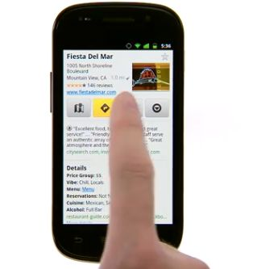
Web Mobile
Develop web applications
for mobile devices

Slide 2

Server Events
Course objectives
By completing this course, you will be able to:
Explain the different ways to manage server events
Use Server Sent Event
Explain what are the advantages of WebSockets
Use WebSockets

Slide 3


Server Events
Course topics
Course’s plan:
Introduction
Server Sent Event
WebSocket

Slide 4

introduction
Web Mobile

Slide 5

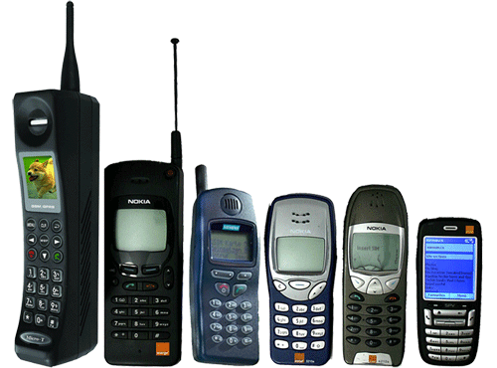
Introduction
Evolution of Mobile Phones

Slide 6
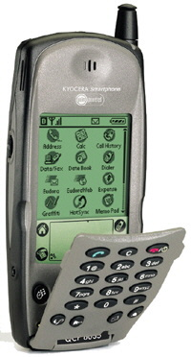
Introduction
Evolution of Smartphones
Kyocera 6035 -
The first smartphone in the American market.
Released in February 2001.
Specifications:
Operating System: Palm OS 3.5
CPU Clock: 16Mhz
RAM: 8MB
ROM: 2MB
Display Diagonal: 2,5”
Display Resolution: 160 x 160

Slide 7
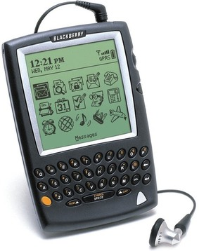
Introduction
Evolution of Smartphones
RIM BlackBerry 5810 -
The first commercialized RIM smartphone.
Released in March 2002.
Specifications:
Operating System: BlackBerry OS 3.6
CPU Clock: 40Mhz
RAM: 1MB
ROM: 8MB
Display Diagonal: 3”
Display Resolution: 160 x 160

Slide 8
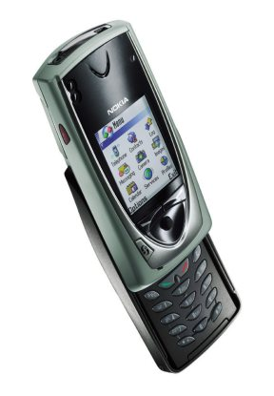
Introduction
Evolution of Smartphones
Nokia 7650 -
The first commercialized Nokia smartphone.
Released in second quarter of 2002.
Specifications:
Operating System: Symbian OS 6.1
CPU Clock: 104Mhz
RAM: 8MB
ROM: 16MB
Display Diagonal: 2.1”
Display Resolution: 176 x 208

Slide 9
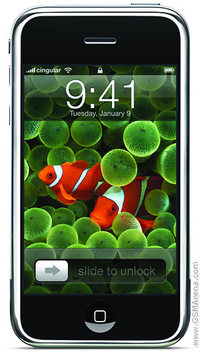
Introduction
Evolution of Smartphones
Apple iPhone -
The first commercialized Nokia smartphone.
Released in September 2007.
Specifications:
Operating System: iPhone OS
CPU Clock: 412Mhz
RAM: 128MB
Storage: 4/8/16GB
Display Diagonal: 3.5”
Display Resolution: 320 x 480

Slide 10
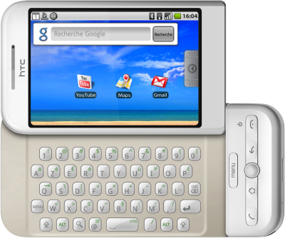
Introduction
Evolution of Smartphones
HTC Dream -
The first commercialized Android phone.
Released in October 2008.
Specifications:
Operating System: Android 1.5 (Cupcake)
CPU Clock: 528Mhz
RAM: 192MB
Storage: 256MB
Removable storage: Up to 16GB microSD
Display Diagonal: 3.2”
Display Resolution: 320 x 480

Slide 11
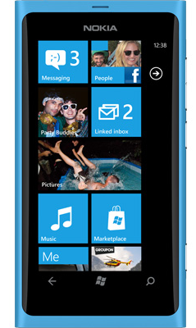
Introduction
Evolution of Smartphones
Nokia Lumia 800 -
The first Windows Phone 7 success (?)
and the reborn of Nokia.
Released in October 2011.
Specifications:
Operating System: Windows Phone 7
CPU Clock: 1,4Ghz
RAM: 512MB
Storage: 16GB
Display Diagonal: 3.7”
Display Resolution: 480 x 800

Slide 12
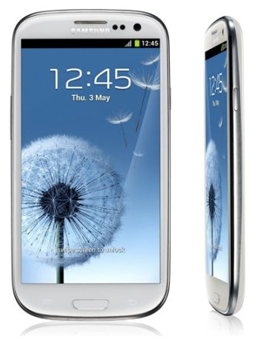
Introduction
Evolution of Smartphones
Samsung Galaxy S III -
A true concurrent for the iPhone.
Released in May 2012.
Specifications:
Operating System: Android 4.0.4
CPU Clock: Quad-core 1.4 GHz
RAM: 1GB
Storage: 16/32/64GB
Removable storage: Up to 64GB microSD
Display Diagonal: 4.8”
Display Resolution: 720 x 1280

Slide 13
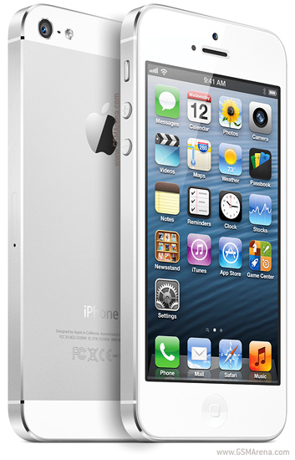
Introduction
Evolution of Smartphones
Apple iPhone 5 -
The last Apple smartphone.
Released in September 2012.
Specifications:
Operating System: iOS 6
CPU Clock: Dual-core 1.2 GHz
RAM: 1GB
Storage: 16/32/64GB
Display Diagonal: 4.0”
Display Resolution: 640 x 1136

Slide 14

Introduction
Evolution of Mobile Networks
 | Data rates
GPRS (2.5G) | ~ 50 Kbit/s
EDGE (2.75G) | ~ 64 Kbit/s
UMTS (3G) | 144 - 2048 Kbit/s
HSDPA (3.5G) | 3.6 - 7.2 Mbit/s
LTE (3.9G) | 40 - 80 Mbit/s

Slide 15
Introduction
Why websites for mobile devices ?
Mobile devices are more and more powerful
Hardware similar to some computers not so old…
Mobile network is faster and faster
Data rates similar to some ADSL connections

Slide 16
Introduction
Why websites for mobile devices ?
Mobile devices bring new useful technologies :
Smartphone is the most personal and mobile media tool
Reaches where other media cannot
Multi-touch
Geo-location
Camera
Accelerometer
NFC
…

Slide 17
Introduction
Why websites for mobile devices ?
The first billion Internet users was reached by the PC, the second will arrive by the mobile.
Google
Since Q4/2010, smartphones (mobile phone, 3G, keyboard, OS, e-mail...) outsell computers for the first time.
IDC Report

Slide 18
Introduction
Web or Native ?
Source of a lot of debate…
A native applications is often more efficient and can use native API
A web application can reach the computer and the mobile worlds regardless of the OS
You just need a browser !

Slide 19
Introduction
One engine to bring them all… (almost)
A lot of different mobile OS…
… but not a lot of different browser engines !
WebKit:
iPhone, iPod, Android, Palm Pre, Nokia, BlackBerry…
Opera Mobile
IE Mobile
…

Slide 20
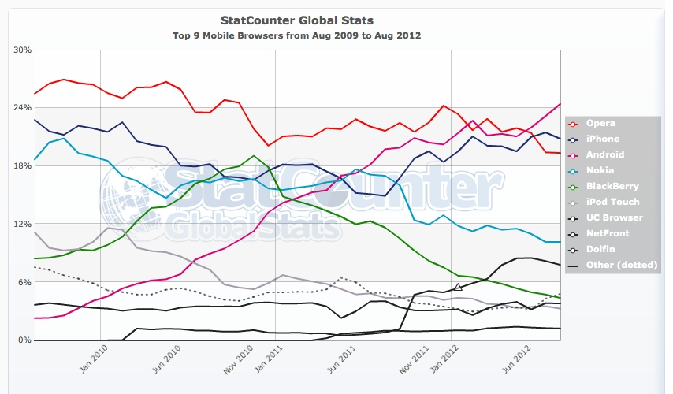

Slide 21


Questions ?

Slide 22


specifications History
Web Mobile

Slide 23
Introduction
History
1997
WAP Forum
1998
Wireless Markup Language
2002
WAP 2.0
XHTML Mobile Profile
WAP Forum joins the Open Mobile Alliance

Slide 24
Introduction
WAP Forum
The WAP Forum main aim:
Bring together the various wireless technologies in a standardized protocol
It was composed of famous actors:
Nokia, Ericsson, Microsoft, Motorola, …

Slide 25
Introduction
WAP & WML
Wireless Application Protocol (WAP)
A technical standard for accessing information over a mobile wireless network
For WAP 1.x, the primary language to design application was:
Wireless Markup Language (WML)

Slide 26
Introduction
WAP & WML
Example of WML page :
<?xml version="1.0"?>
<!DOCTYPE wml PUBLIC "-//WAPFORUM//DTD WML 1.1//EN"
"http://www.wapforum.org/DTD/wml_1.1.xml">
<wml>
<card id="main" title="First Card">
<p mode="wrap">This is a sample WML page.</p>
<a href="wtai://wp/mc;%2B19035551212">A link</a>
</card>
</wml>

Slide 27
Introduction
WAP & XHTML
WAP 2.0 was released in 2002
End-to-end HTTP instead of custom protocol suite
WML replaced by a cut-down version of XHTML
XHTML Mobile Profile

Slide 28
Introduction
WAP & XHTML
Example of XHTML MP page :
<?xml version="1.0" encoding="UTF-8"?>
<!DOCTYPE html PUBLIC "-//WAPFORUM//DTD XHTML Mobile 1.2//EN"
"http://www.wapforum.org/DTD/xhtml-mobile10.dtd">
<html xmlns="http://www.w3.org/1999/xhtml" xml:lang="en">
<head>
<title>Hello world</title>
</head>
<body>
<p>Hello <a href="http://example.org/">world</a>.</p>
</body>
</html>

Slide 29
Introduction
History
2001
XHTML Basic 1.0
2004
Creation of the WHATWG
2007
The W3C adopts the WHATWG HTML5
2008
XHTML Basic 1.1
XHTML MP 1.2

Slide 30
Introduction
XHTML Basic
XHTML Basic is a W3C specification
Subset of XHTML 1.1
Suitable for mobile phones, PDAs, pagers, and interactive televisions

Slide 31
Introduction
XHTML MP or XHTML Basic ?
What is the difference between XHTML MP and XHTML Basic ?
XHTML MP was designed before the W3C finished the XHTML specification
In 2008, the two specifications became the same language

Slide 32
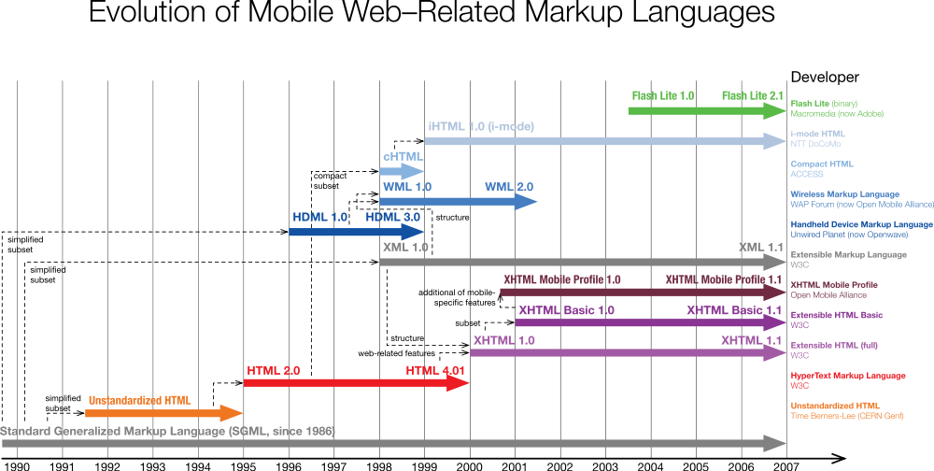

Slide 33
Introduction
And HTML 5 ?
Remember what we said :
Many features of HTML5 have been built with the consideration of being able to run on low-powered devices such as smartphones and tablets
XHTML and its different sub-sets will be phased out and replaced with it

Slide 34
Questions ?

Slide 35
Good Practices
Web Mobile

Slide 36
Good Practices
Presentation
In July 2008, the W3C publish the Mobile Web Best Practices 1.0 basic guidelines
Usable Screen Width: 120 pixels, minimum
Markup Language: XHTML Basic 1.1
Maximum Total Page Weight: 20 KB
No JavaScript, no frames
…
Notes:
http://www.w3.org/TR/mobile-bp/

Slide 37
Good Practices
Presentation
This guideline is very interesting but 5-years-old
If you want to target only recent mobile devices, you can break some of those practices
Most of them support JavaScript and have a larger screen
Notes:
http://www.w3.org/TR/mobile-bp/

Slide 38
Good Practices
Mobile Website URL
What is the better URL for your mobile site ?
http://m.website.fr ?
http://website.mobi ?
http://website.fr/mobile ?
Or the same than for computers: http://website.fr ?

Slide 39
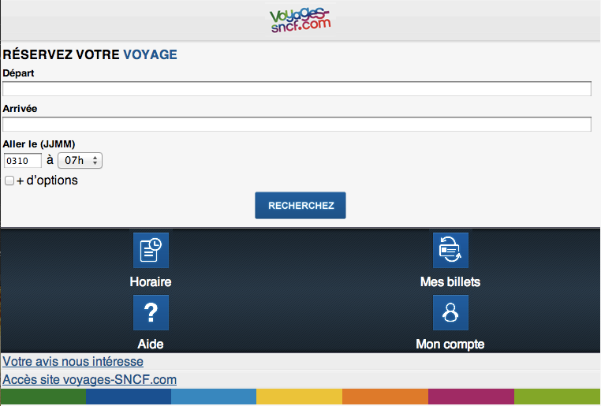
Good Practices
Mobile Website URL - Case study
Do you know http://voyages-sncf.mobi ?
A mobile version of http://voyages-sncf.com

Slide 40
Good Practices
Mobile Website URL - Case study
If a mobile user go to the desktop version
He’s not redirected to the mobile version
If a desktop user go to the mobile version
He’s not redirected to the desktop version

Slide 41
Good Practices
Mobile Website URL - Case study
How a user go to the Voyages SNCF website ?
With Search Engines !
If you Google “Voyages SNCF”
You can find the mobile website around page 3 !

Slide 42
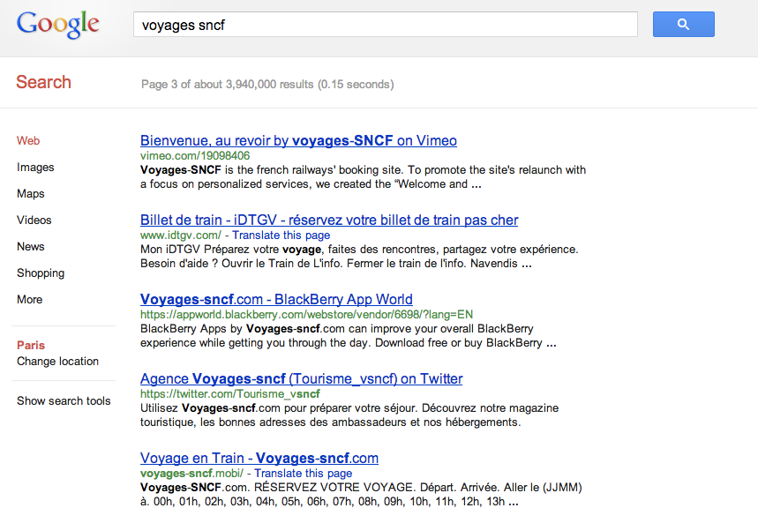
Good Practices
Mobile Website URL - Case study
Query
SERP number
Mobile version

Slide 43
Good Practices
Mobile Website URL - Case study
SEO is difficult for mobile websites
For Search Engines, the desktop and mobile version are competitors
But you can now fix that with the following link element:
<link rel="canonical" href="http://mywebsite.com" />
Notes:
You can read the 1JWB course for more information.

Slide 44
Good Practices
Mobile Website URL
The Mobile Web Best Practices 1.0 advises to follow the One Web principle :
Ensure that content provided by accessing a URI yields a thematically coherent experience when accessed from different devices.
Notes:
You can read the 1JWB course for more information.

Slide 45

Notes:
http://www.web-tambouille.fr/2011/09/18/optimiser-votre-site-web-sur-mobile-jug-summer-camp-2011-slides.html

